Slide 1

Lecture 05: Digital System Design
Dept. of Computer Sc. and Engg.
University of Rajshahi
www.ru.ac.bd
Dr. Mahboob Qaosar

Slide 2
Multiplexer (MUX)
A MUX is a digital switch that has multiple inputs (sources) and a single output (destination).
The select lines determine which input is connected to the output.
MUX Types
→ 2-to-1 (1 select line)
→ 4-to-1 (2 select lines)
→ 8-to-1 (3 select lines)
→ 16-to-1 (4 select lines)
Multiplexer
Block Diagram
2^{N}
1
Inputs
(sources)
MUX
Output
(destination)
N
Select
Lines

Slide 3

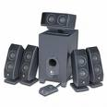
Typical Application of a MUX
Multiple Sources
Selector
Single Destination
MP3 Player
Docking Station
D0
D1
D2
D3
Laptop
Sound Card
MUX
Y
Surround Sound System
Digital
Satellite
B | A | Selected Source
0 | 0 | MP3
0 | 1 | Laptop
1 | 0 | Satellite
1 | 1 | Cable TV
Digital
Cable TV
Notes:
This slide shows a typical application of a multiplexer (in this case a 4-to-1 MUX). Have the students share other common applications of MUXs.
http://images.tigerdirect.ca/skuimages/large/Logitech-X-540-L23-7250-mai.jpg

Slide 4
Example: A 4-to-1 Multiplexer
A 4-to-1 Multiplexer:
I0
2^{n} inputs
I1
F
I2
1 output
I3
Enable (G)
S0
S1
n control inputs

Slide 5
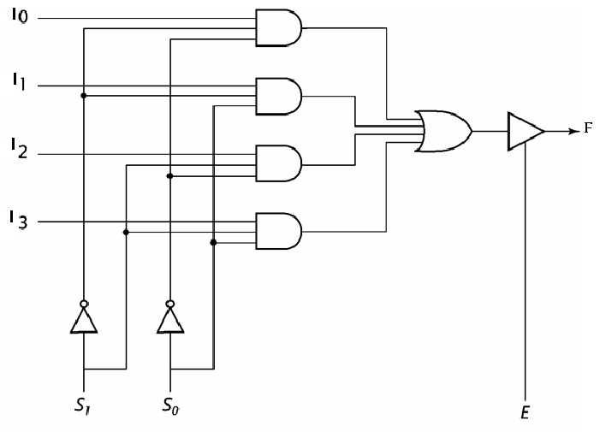
4-to-1 Multiplexer
S₁ | S₀ | F
0 | 0 | I₀
0 | 1 | I₁
1 | 0 | I₂
1 | 1 | I₃
Notes:
5

Slide 6
4-to-1 Multiplexer Waveforms
I0
I1
I2
I3
S0
S1
F
 | I0 | I1 | I2 | I3 | I0 | I1 | I2 | I3
Input
Data
Select
Line
Output
Data
Notes:
Waveform diagram for a 4-to-1 MUX. The input data signals (D0-D3) are colored RED to indicate when its is connected to the output Y. Note: There is no significance to the values of the four input data signals; they are intended solely to demonstrate that the select lines (A & B) will select what input data signal will be connected to the output.

Slide 7
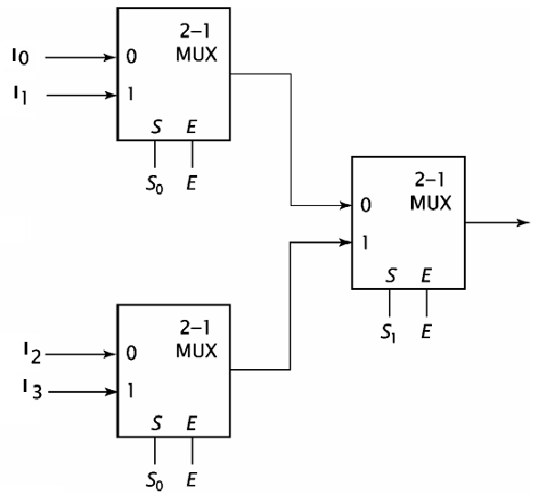
Cascading multiplexers
Using three 2-1 MUX to make one 4-1 MUX
F
S₁ | S₀ | F
0 | 0 | I0
0 | 1 | I1
1 | 0 | I2
1 | 1 | I3
Notes:
7

Slide 8
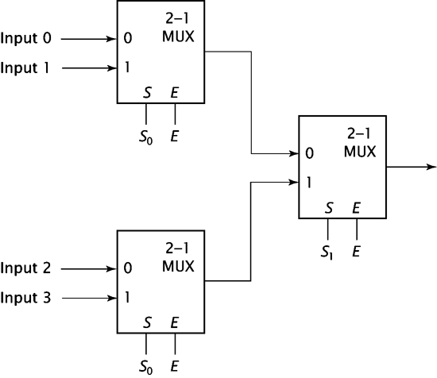
Example: Construct an
8-to-1 multiplexer using
2-to-1 multiplexers.
I₀
I₁
S₂ | S₁ | S₀ | F
0 | 0 | 0 | I₀
0 | 0 | 1 | I₁
0 | 1 | 0 | I₂
0 | 1 | 1 | I₃
1 | 0 | 0 | I₄
1 | 0 | 1 | I₅
1 | 1 | 0 | I₆
1 | 1 | 1 | I₇
I₂
I₃
2-1
MUX
F
S E
I₄
I₅
S₂ E
I₆
I₇
Notes:
8

Slide 9
Multiplexer Versus Decoder
A Multiplexer uses n binary select bits to choose from a maximum of 2^{n} unique input lines.
Multiplexers and decoders both can decode minterms.
Decoders have n number of output lines while multiplexers have only one output line.
The decoded minterms are used to select data from one of up to 2n unique data input lines.
The output of the multiplexer is the data input whose index is specified by the n bit code.
Notes:
9

Slide 10
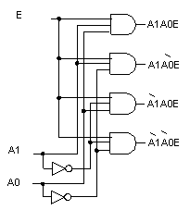
Multiplexer Versus Decoder
2-t0-4 Decoder
4-to-1 Multiplexer
Note that the multiplexer has an extra OR gate. A1 and A0 are the two inputs in decoder. There are four inputs plus two selecs in multiplexer.
Notes:
10

Slide 11
Demultiplexer (DEMUX)
A DEMUX is a digital switch with a single input (source) and a multiple outputs (destinations).
The select lines determine which output the input is connected to.
DEMUX Types
→ 1-to-2 (1 select line)
→ 1-to-4 (2 select lines)
→ 1-to-8 (3 select lines)
→ 1-to-16 (4 select lines)
Demultiplexer
Block Diagram
1
2^{N}
Input
(source)
DEMUX
Outputs
(destinations)
N
Select
Lines
Notes:
This slide explains the function of a demultiplexer.

Slide 12
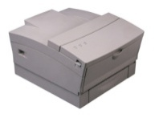
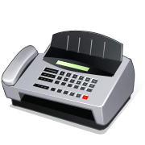
Typical Application of a DEMUX
Single Source
Selector
Multiple Destinations
B/W Laser
Printer
Fax
Machine
D0
D1
D2
D3
X
DEMUX
Color Inkjet
Printer
B | A | Selected Destination
0 | 0 | B/W Laser Printer
0 | 1 | Fax Machine
1 | 0 | Color Inkjet Printer
1 | 1 | Pen Plotter
Pen
Plotter
Notes:
This slide shows a typical application of a demultiplexer (in this case a 1-to-4 DEMUX). Ask students to share other common applications of DEMUXs.

Slide 13
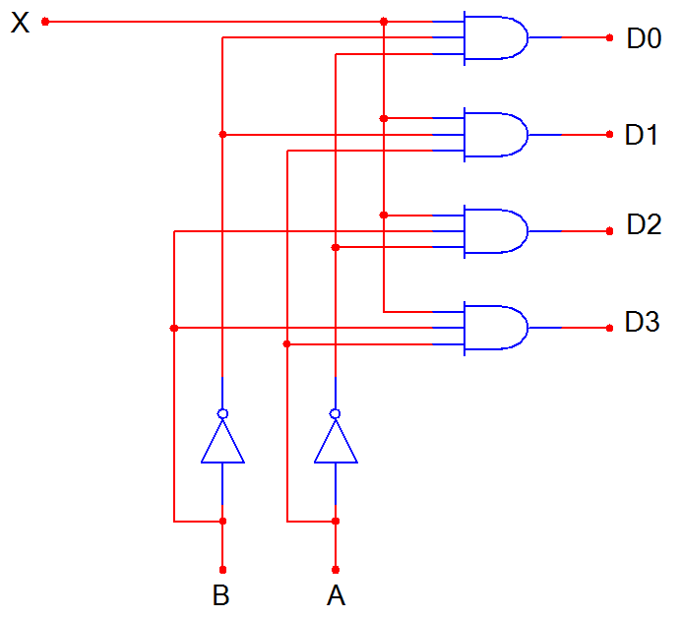
1-to-4 De-Multiplexer (DEMUX)
D0
D1
D2
D3
X
DEMUX
S1 S0
S1 | S0 | D0 | D1 | D2 | D3
0 | 0 | X | 0 | 0 | 0
0 | 1 | 0 | X | 0 | 0
1 | 0 | 0 | 0 | X | 0
1 | 1 | 0 | 0 | 0 | X
S1 S0
Notes:
SSI logic diagram, block diagram, and truth table for a 1-to-4 De-MUX

Slide 14
1-to-4 De-Multiplexer Waveforms
X
S0
S1
D0
D1
D2
D3
Input
Data
Select
Line
Output
Data
Notes:
Waveform diagrams for a 1-to-4 De-MUX. The output signals (D0-D3) are colored RED to indicate when its is connected to the input X. Note: There is no significance to the value of the input data signal; it is intended solely to demonstrate that the select lines (A & B) will determine what output signal is connected to the input.

Slide 15
End

